Slide 1
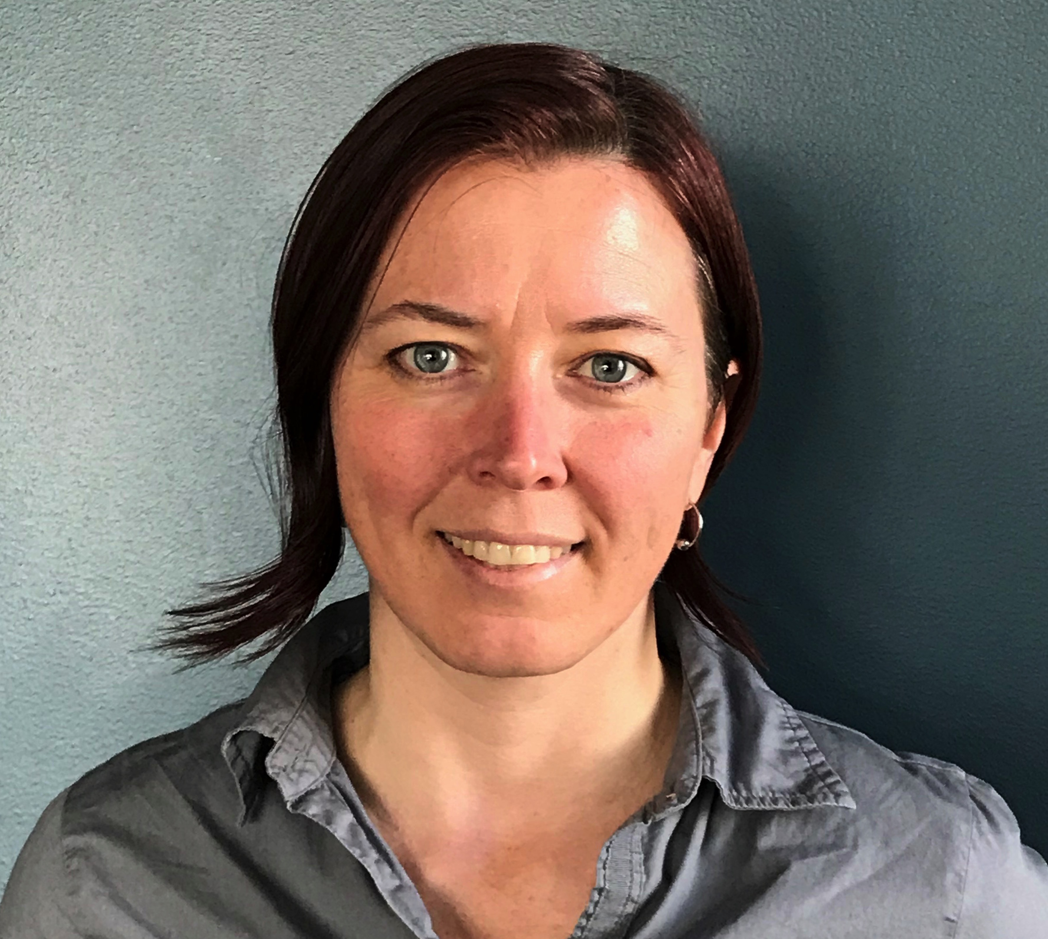
Healthy Indoor Air Quality - COVID 2.0
Melissa Sokolowsky Senior Project Manager
melissa.sokolowsky@neec.net
Northwest Energy Efficiency Council
Smart Buildings Center
smartbuildingscenter.org
Notes:
Manager of SBC Tool Lending Library
BOC Training and Curriculum Manager
My previous background: Facilities Management, Energy Management, Facility Operation
I understand the extra challenges in facility operation that this current reality brings, which is why I’m here today to talk about some strategies to mitigate the risk.

Slide 3
Notes:
Tool resources section on TLL website, tool demos, etc.

Slide 5
Certified Building Operators in the PNW save their orgs $12,000 annually!

Slide 6
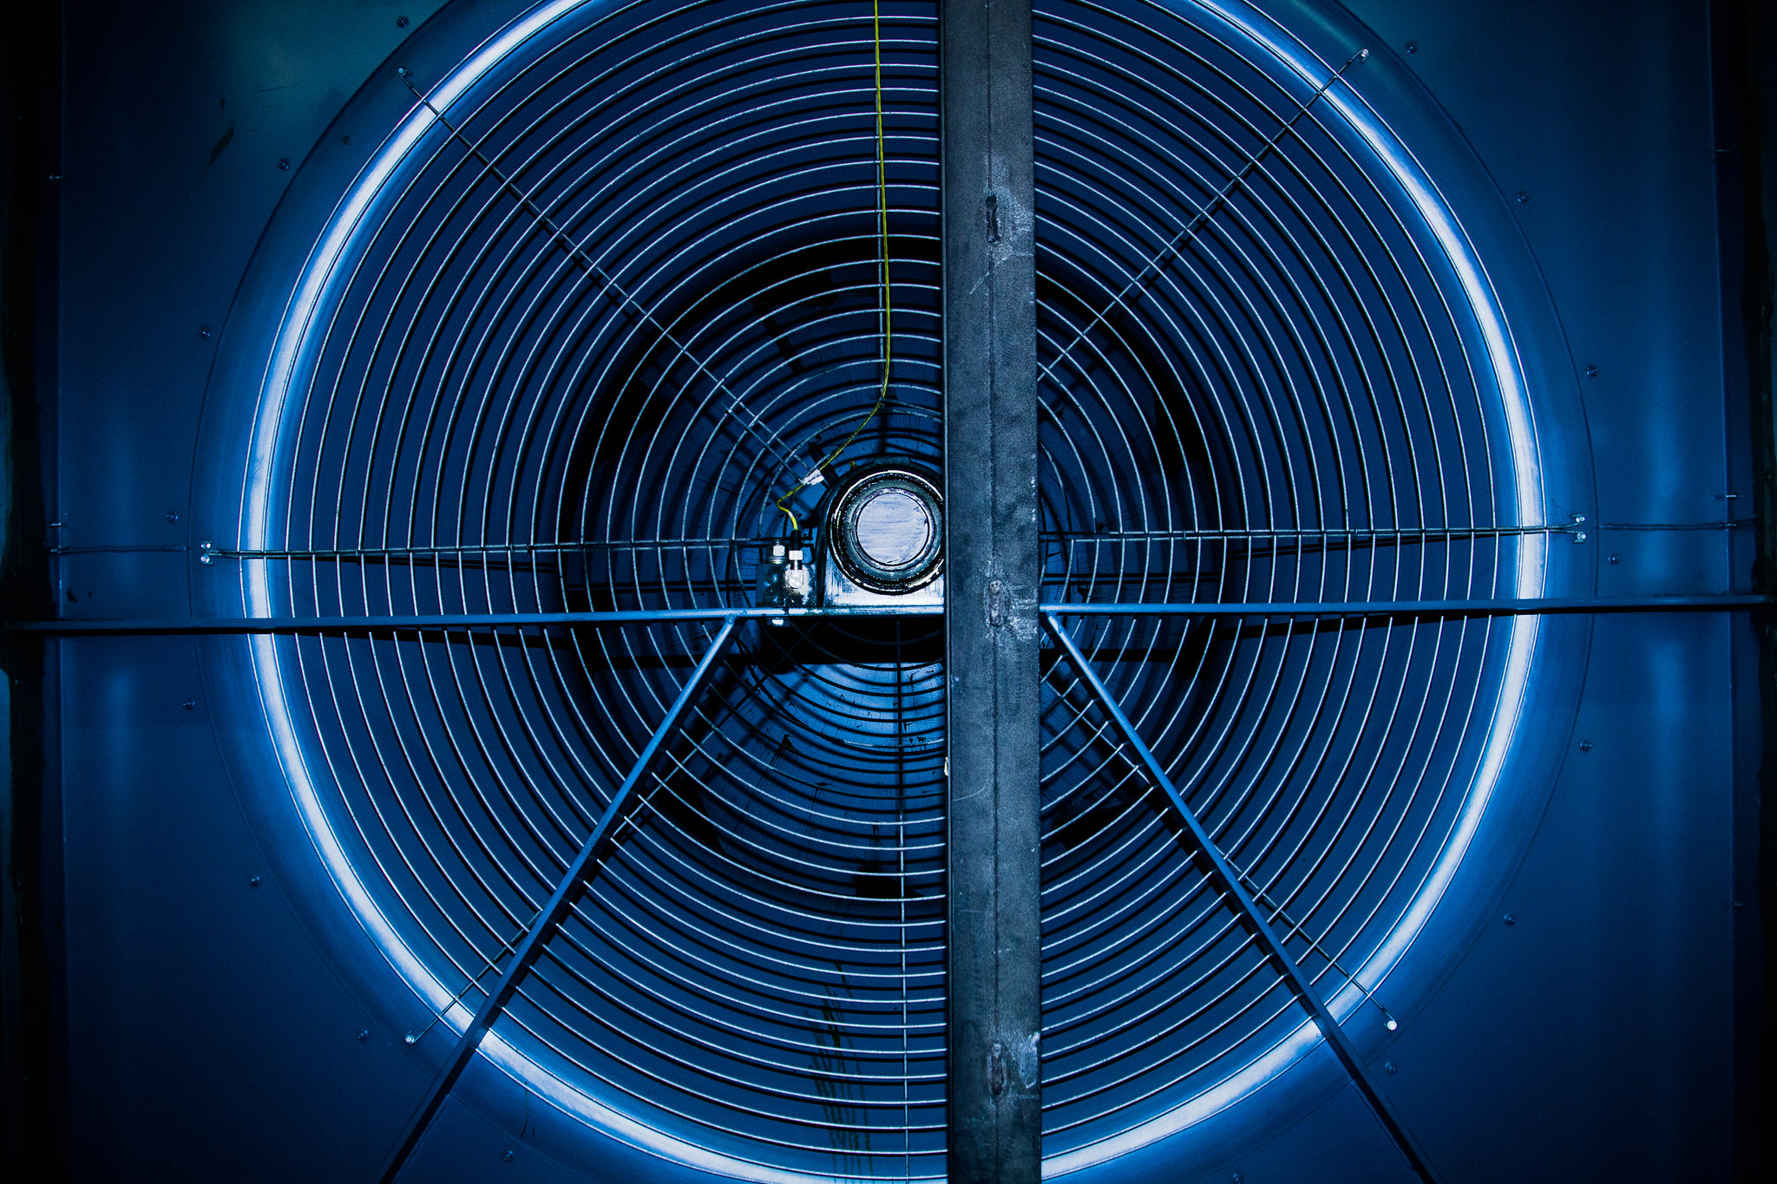
Learning Objectives
Understand that HVAC systems can facilitate strategies for minimizing risk from airborne infectious diseases
Review the basics of airborne virus transmission
Identify resources to inform decisions
Discuss various HVAC strategies and best practices for minimizing risk
Understand value of diagnostics in formulating a strategy for a specific building
Photo courtesy of Resource Media

Slide 7
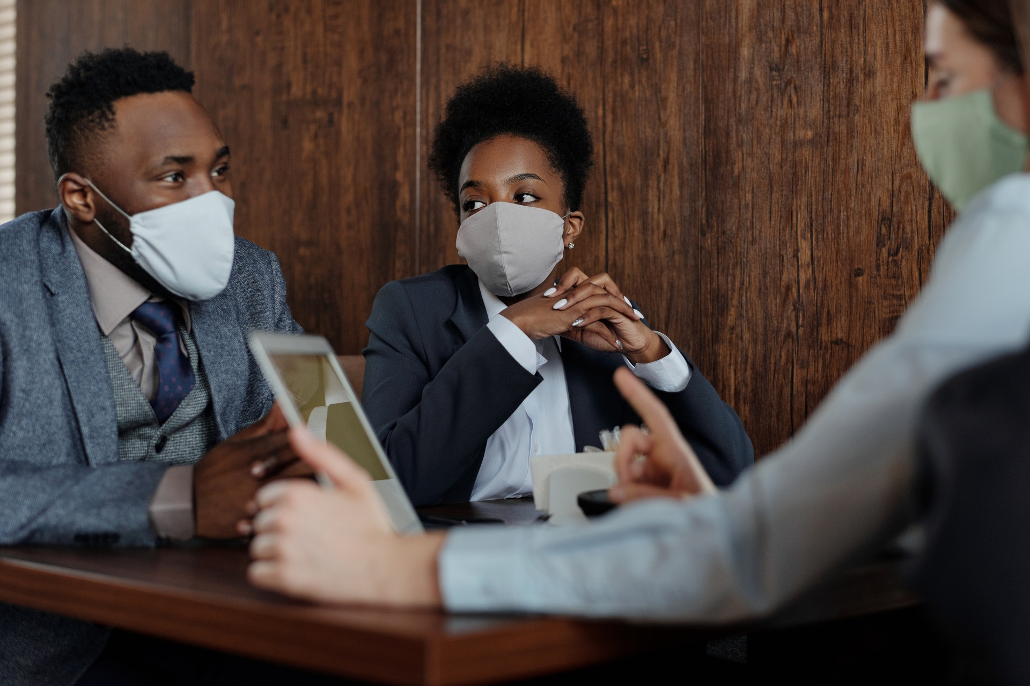
COVID 2.0 Era
Beginning to re-occupy buildings
Still in pandemic – highly infectious novel coronavirus
Facility Professionals’ Challenge: How to operate while minimizing risk?
HVAC system strategies can help
Photo by August de Richelieu from Pexels
Notes:
COVID 2.0 refers loosely to the “Phase 2” designation many jurisdictions have deemed as appropriate for starting the reopening of more non-essential buildings to some level of occupancy.
The following guidance summarizes some best practices (provided by the American Society of Heating, Refrigeration and Air Conditioning Engineers, or ASHRAE, and the Federation of European Heating, Ventilation, and Air Conditioning Associations, or REHVA) to reduce the spread of the virus in buildings, focusing on airborne transmission. The objective of this guidance is to provide practical information about recommended precautions and dispel certain myths that can lead to unnecessary actions.

Slide 8
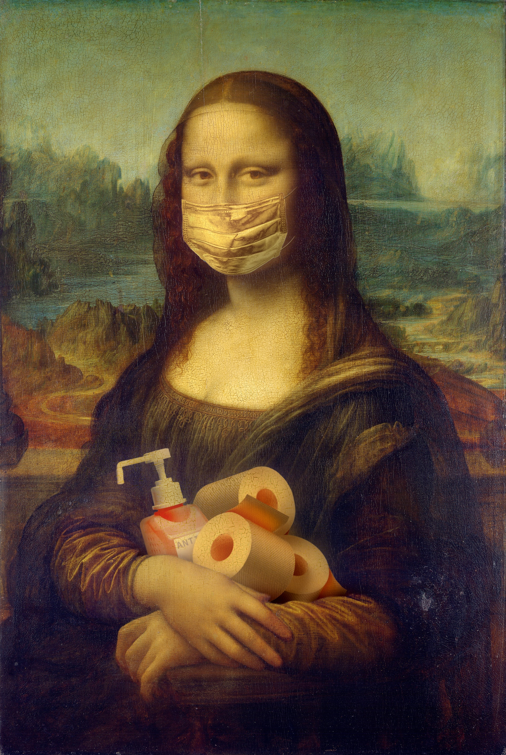
Evolving Protocols
New virus – still learning
Recommended protocols may change
Buildings and occupancy circumstances vary widely
Inform operation change decisions with:
Latest available recommendations – ASHRAE, REHVA
Facility reference documents
Professionals who understand the specific building
Photo by Yaroslav Danylchenko from Pexels
Notes:
As the current response to the COVID-19 pandemic has drastically altered many of our daily routines, so too must our facility operation practices change to provide the best possible protection for occupants. (Note: guidance provided is based on the most current information available; as understanding of this new virus increases, recommended best practices may change. Also, circumstances in buildings vary widely depending on many factors; decisions to make proposed changes should be informed by facility reference documents and consultation with professionals who understand the specific building.)

Slide 9
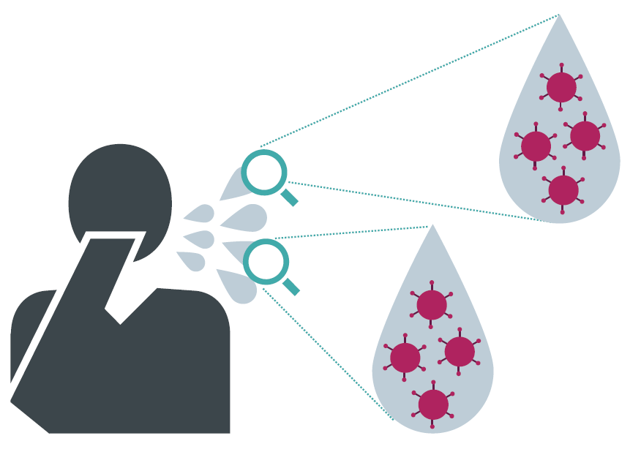
Airborne Virus Transmission
Most frequently spread by droplets
Sneezing
Coughing
Talking
Large droplets (>10 microns)
Can fall 6 feet away
Virus remains active on surfaces 2-3 days
Infection happens by:
touching membranes
breathing in droplets
Photo courtesy of Siemens
Notes:
As most people are now aware, this virus is highly contagious and is most frequently spread by droplets emitted from an infected person through sneezing, coughing, or even talking. Large droplets (>10 microns) can fall up to about 6 feet away. The virus in these droplets can generally remain active on surfaces for 2-3 days. Virus transmission commonly occurs from people touching these surfaces and then touching the mucous membranes on their faces (eyes, nose, mouth). Sanitization protocols in facilities should be increased all over but especially on high-touch surfaces. Transmission can also occur by directly breathing in droplets expelled by an infected person. Wearing masks can help to reduce this occurrence. Additionally, smaller droplets (<5 microns) carrying the virus can remain active for up to about 3 hours airborne and can be moved large distances through a building by air travel. Thus, effective ventilation practices are also key to reducing the risk of transmission via airborne particles in buildings.

Slide 10
Airborne Virus Transmission
Smaller droplets (<5 microns)
Airborne can remain active for several hours
Can move large distances through building via air travel
Ventilation strategies are key to reducing risk
Photo by Chokniti Khongchum from Pexels
Notes:
Additionally, smaller droplets (<5 microns) carrying the virus can remain active for several hours (some research indicates it is up to about 3 hours but that is not conclusive) airborne and can be moved large distances through a building by air travel. Thus, effective ventilation practices are also key to reducing the risk of transmission via airborne particles in buildings.

Slide 11
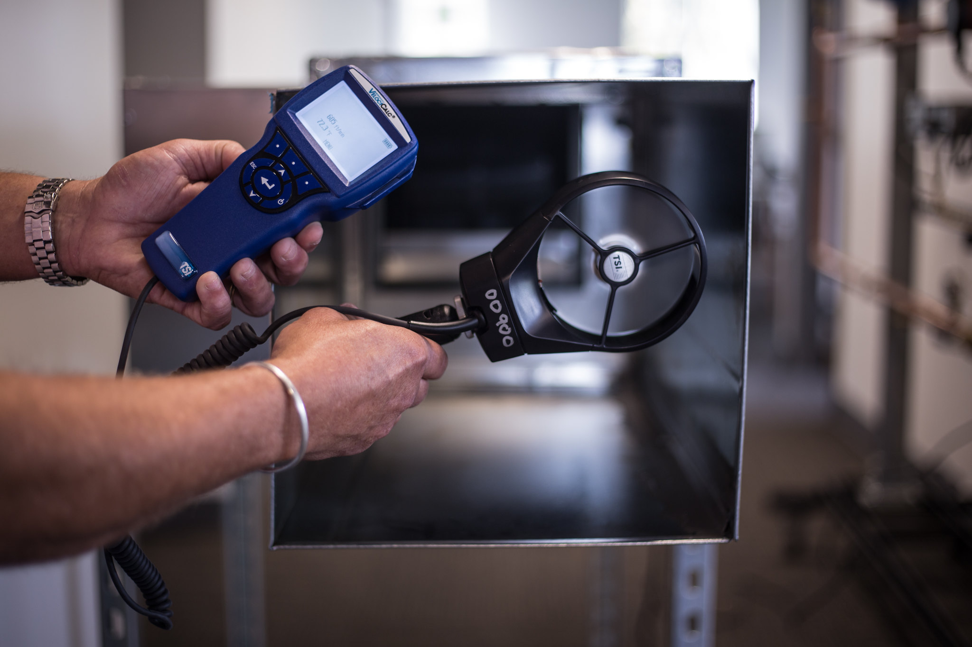
Ventilation Strategies (ASHRAE)
Dilute
Exhaust
Control humidity
Clean
Photo courtesy of Resource Media
Notes:
ASHRAE’s recommendations can be categorized into 4 main strategies. Since every building is different, best practice will vary as a mixture of these elements may ultimately be reasonably implemented.

Slide 12
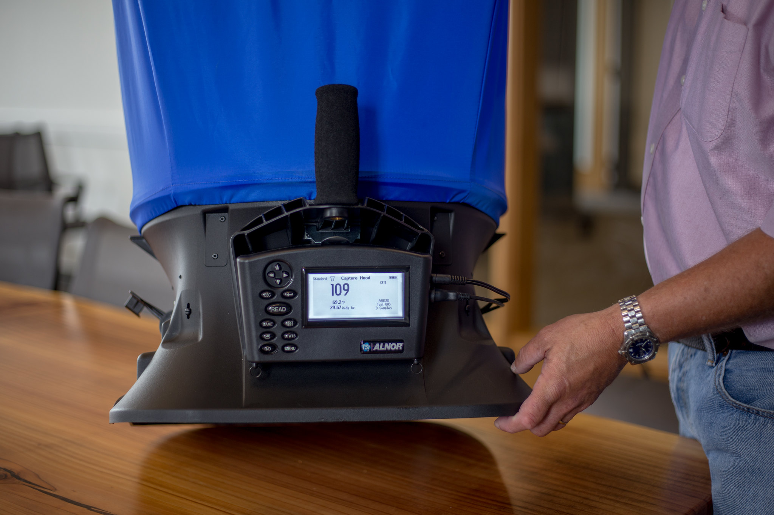
HVAC System Diagnostics
Help verify systems are working as designed
Identify issues
Pressure
Exhaust
Filtration
Find opportunities within the system
Controls settings
Manual equipment adjustments
Consider cost effectiveness of additional equipment/measures
Photo courtesy of Resource Media
Notes:
Building system diagnostics can help determine the best course of action. Lowest cost – maximize existing systems capabilities to help mitigate risk. The Smart Buildings Center’s Tool Lending Library can help facility managers and operators assess conditions and optimize the building environment to minimize risk during the ongoing response and as we move to re-occupy our buildings. Throughout this presentation, we’ve highlighted tools in our library that can support your efforts to effectively prepare and maintain your building in response to the COVID-19 pandemic; please reach out to us if you have questions at tool-library@smartbuildingscenter.org.

Slide 13
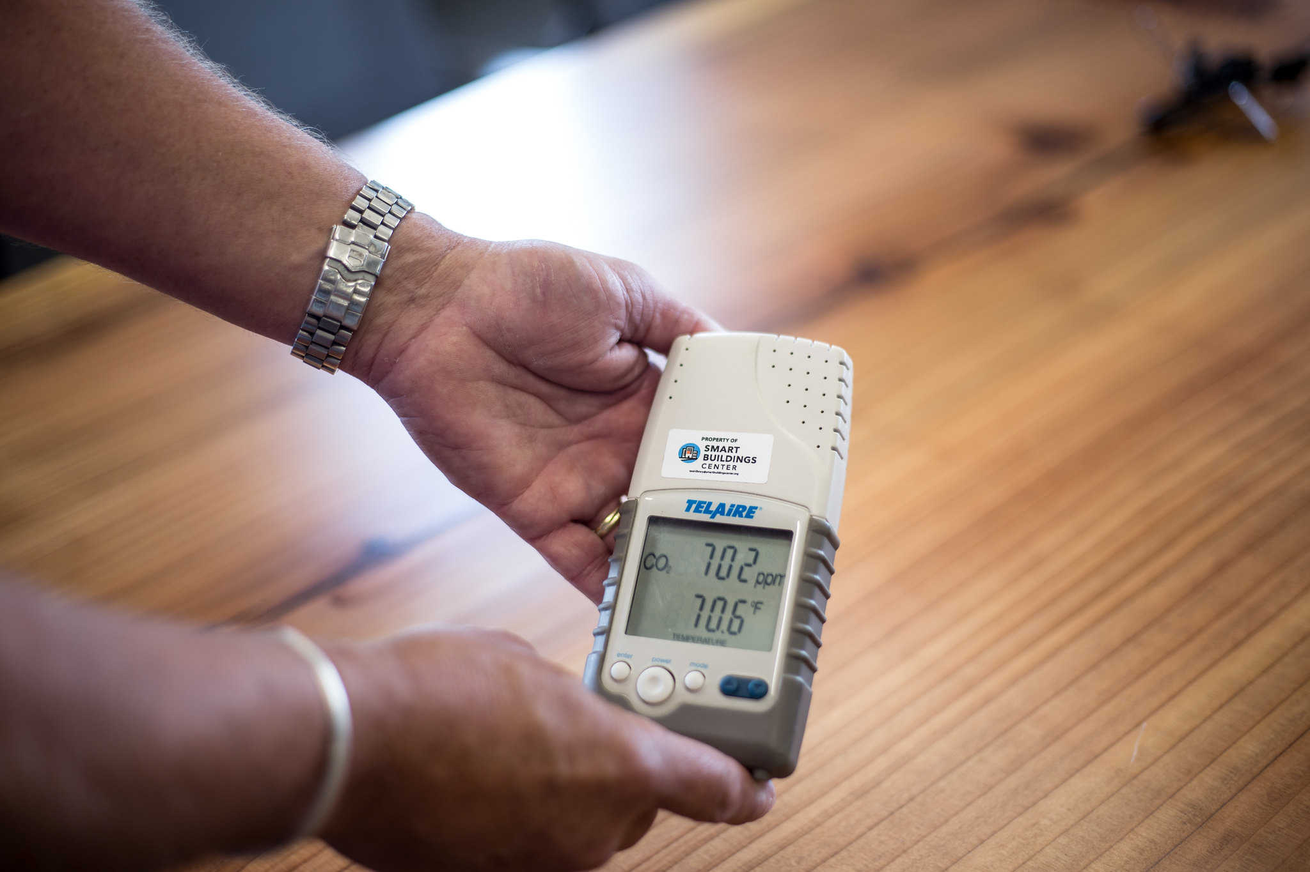
Dilution
As much outdoor air (OA) as reasonably possible
Close recirculation dampers (manually or via BAS)
Increase OA damper flow
Change setpoints
Use operable windows when possible
Turn off demand-controlled ventilation (or change settings)
Photo courtesy of Resource Media
Notes:
When thinking about ventilation, the most important recommendation is to supply as much outdoor air as is reasonably possible. Close recirculation dampers manually or turn recirculation off via the building automation system (and verify it is off). Turn demand-controlled ventilation off or set it to operate near outdoor air concentrations (typically around 400 ppm); CO2 loggers are available from the Tool Lending Library to use for verification of outside air levels.
Since the temperature levels needed to affect this virus fall outside of practical ranges for building operation, there is no need to alter set points for heating or cooling. Operable windows should be used to supplement mechanical systems where possible. In buildings without mechanical ventilation, use of operable windows is critical. Tool Lending Library equipment such as airflow meters, balometers (airflow capture hoods), and motor loggers can be useful to assess adequacy of airflow and make sure equipment is operating as intended during unoccupied hours.
When possible, ASHRAE recommends operating the equipment with 100- percent outdoor air, but this will require capacity to properly condition this excess outdoor airflow during extreme weather conditions. Controls should be adjusted to maximize ventilation whenever possible, without sacrificing acceptable temperature or humidity control in the building.

Slide 14
Schedules
Flush building by running ventilation systems
Nominal speed
At least two hours before occupancy
At least two hours after occupancy
Run ventilation during unoccupied hours
As much as reasonable
Reduced speed
Notes:
Ventilation schedules and volumes should be addressed. Running ventilation systems at nominal speed at least 2 hours ahead of building occupation time, and then lowering the speed 2 hours after normal occupancy is recommended. Keep the ventilation systems running during unoccupied hours such as nights/weekends, but at a lower speed. This applies to vacated buildings as well. During the shoulder seasons in many regions, the increased energy use resulting from this practice can hopefully be minimized due to minimal need for heating and/or cooling. Tool Lending Library equipment such as airflow meters, balometers (airflow capture hoods), and motor loggers can be useful to assess adequacy of airflow and make sure equipment is operating as intended during unoccupied hours.

Slide 15
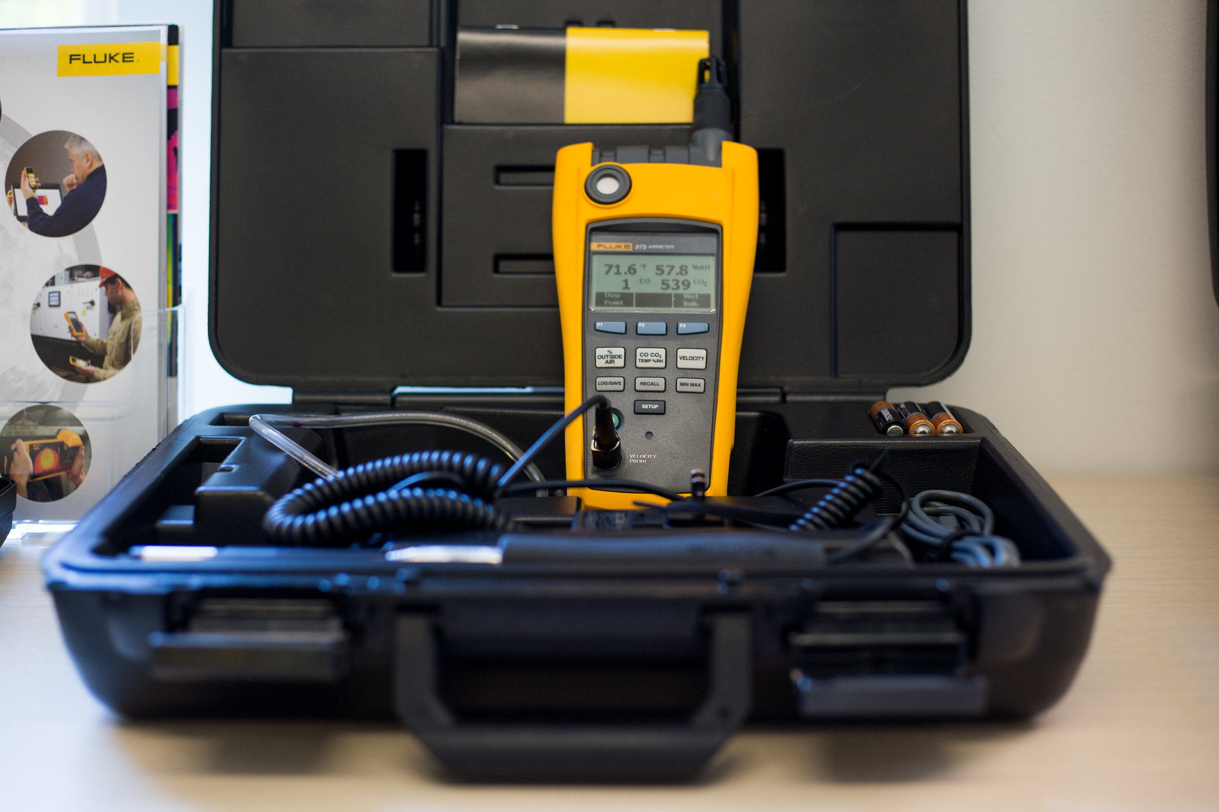
Exhaust
Remove contaminants
Avoid positioning occupants in return air stream
Avoid negative building pressure – bring in sufficient outside air
Keep restroom exhaust fans operating continuously
Keep restroom windows closed
Photo courtesy of Resource Media
Notes:
This category involves removing contaminants as close to the source as possible. To prevent negative building pressure, especially during humid weather, make sure the ventilation system is simultaneously supplying a sufficient quantity of conditioned outdoor air to replace the exhausted air. Restroom exhaust should operate continuously.
The exception to using operable windows for ventilation is in restrooms, where an open window can reverse the flow of ventilation and contaminate other rooms, especially in cases of passive stack exhaust. Toilet ventilation should operate 24/7. Restroom windows should remain closed, except when there is no other adequate exhaust available, in which case windows in other spaces should also be kept open to achieve cross flows through the building. Tools such as airflow meters or a simple smoke pencil, available from the Tool Lending Library, can be useful in determining that exhaust systems are operating safely as intended.

Slide 16
Exhaust cont.
Instruct occupants to close toilet lids before flushing if possible (avoid creating more virus-containing aerosols)
Maintain proper operation of water seals
Avoid dried-out floor drains/ other sanitary devices
Notes:
Occupants should be instructed to flush toilets with the lids closed (where possible), as droplets containing virus can be dispersed to the air by plumes created when toilets are flushed. Also, maintain proper operation of water seals by avoiding dried-out floor drains and other sanitary devices; add water regularly (about every 3 weeks depending on climate).

Slide 17
Pressure issues
Heat recovery equipment can leak
Improper installation
Inadequate maintenance
Correct pressure issues (i.e. adjust dampers)
Consider bypass depending on type of system
Notes:
Properly installed and maintained heat recovery equipment can achieve near-zero transfer of contaminated particles; however, many heat exchangers have not been properly installed (i.e. higher pressure on the exhaust side which can cause leakage from exhaust air into supply air). Leaks are also common because of inadequate maintenance. Check heat recovery equipment and be sure that leakage is minimized as much as possible. Pressure adjustments can be made using dampers or other strategies, and some systems are equipped with a heat recovery bypass function. Leakage is higher at lower airflow rates; thus higher ventilation rates are helpful. Tools available from the Tool Lending Library, such as manometers or other pressure gauges, can be useful for assessing and correcting pressure issues. In some cases, ultrasonic leak detectors may also be helpful. PPE should always be worn when making these types of assessments.

Slide 18
Control Humidity
Maintain humidity between 40 and 60 percent
Add sensors (wireless options available)
Reprogram controls
Consider disabling discharge air temperature (DAT) reset during humid weather
Ensure hot water heating system enabled to provide reheat for humidity control, if necessary
Install new equipment or components
Notes:
Maintain indoor relative humidity between 40 percent and 60 percent. For existing buildings, adding wireless humidity sensors may be a viable option as they are typical less expensive to install than their wired counterparts. Controls may need to be reprogrammed to accomplish humidity in this range, or installing new equipment or new components in existing equipment may be required. For cold and dry climates, this might involve adding humidification equipment. For conventional VAV systems, disabling discharge-air temperature (DAT) reset during humid weather will keep indoor humidity levels lower, but may increase overall system energy use. Also, ensure that the hot-water heating system is enabled, not turned off, so it can provide reheat for humidity control, if necessary.

Slide 19
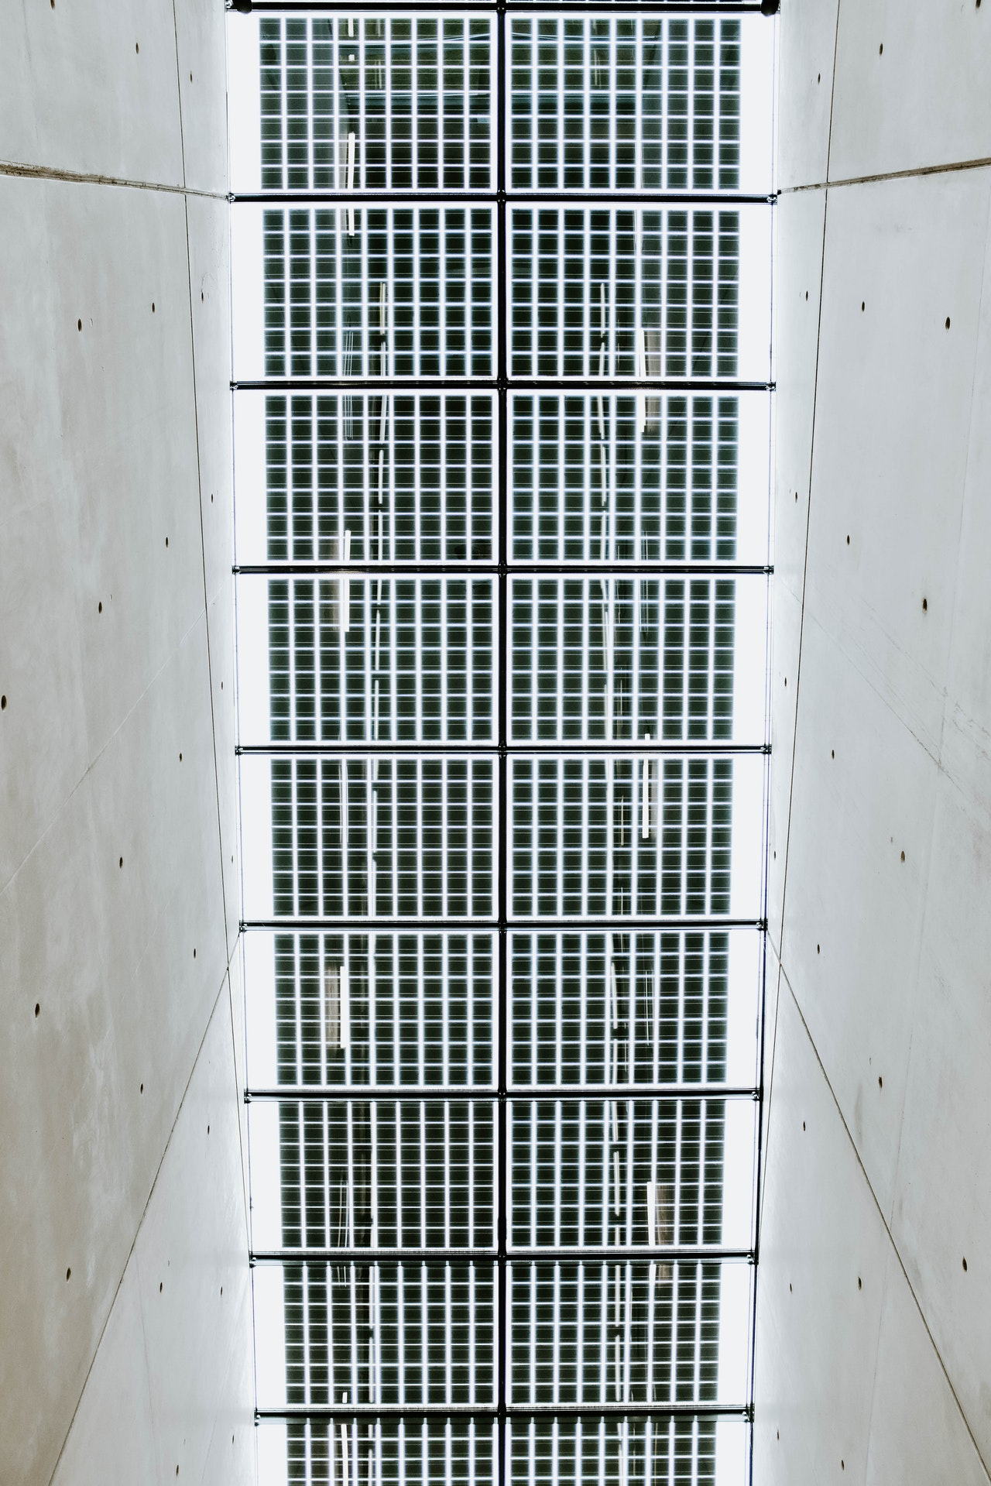
Cleaning Strategies
Virus-contaminated OA is rare
Upgrade return/recirculation filters - MERV-13
Potential for higher static pressure loss
Ensure sufficient fan capacity
May lose energy efficiency
Ensure effective air sealing around filter media
Turn off system and use PPE (respiratory, gloves) when changing ANY filters
Dispose of used filters in sealed bag
Photo by Adrien Olichon from Pexels
Notes:
Virus-contaminated outside air is rare, and standard outdoor air filters typically provide effective fine-particle protection (as opposed to common return/recirculation air filters, which are designed primarily for dust and do not normally filter out particles with viruses effectively). There is no need to increase or alter the normal schedule of changing these filters. But personal protective equipment (PPE) such as gloves and respiratory protection should always be worn by technicians when changing any filters, especially return or exhaust filters. To be safe, technicians should operate under the assumption that filters contain active microbiological material, including viruses. Turn the system off while changing the filter(s) and dispose of used filters in a sealed bag.
Upgrade filters to MERV-13 (or higher) and ensure effective air seals. (MERV = Minimum Efficiency Reporting Value). Keep in mind this will likely produce a higher static pressure loss, which will usually increase fan energy use. Therefore, make sure the equipment has sufficient capacity to overcome this loss.

Slide 20
Cleaning Strategies, cont.
Portable room air cleaners
HEPA (best)
High-MERV rating (good)
Ultraviolet lamps in ductwork/ air handling equipment
Other air-cleaning technologies in marketplace
Photocatalytic oxidation
Bipolar ionization
Notes:
Add portable room air cleaners with HEPA or high-MERV filters. If upgrading existing filters is not feasible, ASHRAE recommends adding portable room air cleaners with high efficiency particulate air (HEPA) filters, or filters with a high MERV rating (see previous recommendation). UV lamps are also an option as well as other air cleaning technologies in the marketplace (including photocatalytic oxidation and bipolar ionization). When applying these other technologies, consider the manufacturer’s test data carefully and follow their instructions for installation.

Slide 21
Duct Cleaning?
Likely unnecessary
Virus particles do not attach easily to duct surfaces
More important to increase fresh air, avoid recirculation
Notes:
There is a misconception that duct cleaning is required to minimize spread of the virus in buildings; however, this is likely an unnecessary practice since virus particles do not attach easily to duct surfaces. It is much more important to increase fresh air supply and avoid recirculation of air.
In the case of small spaces served by standalone fan coil or induction units that work with room level circulation, if possible, it is recommended these units be turned off to avoid airborne suspension of virus particles. If they cannot be turned off (i.e. there is a cooling need) then it is recommended to operate their fans continuously, since the virus can settle in the filters (which are typically coarse and not effective at trapping fine virus particles) and then resuspension is increased when the fan is turned back on. If the fan is running continuously, virus particles will theoretically be removed with exhaust ventilation. Room air cleaners with at least HEPA filter efficiency or special UV equipment may also be effective at removing virus particles in smaller spaces.

Slide 22
Conclusion
HVAC systems can facilitate strategies for minimizing risk from airborne infectious diseases
Review:
Novel coronavirus is most commonly spread via airborne transmission
Resources to inform decisions – ASHRAE, professionals who understand the specific building
Many various HVAC strategies and best practices for minimizing risk
Diagnostics are valuable in formulating a strategy for a specific building

Slide 23
Tool Lending Library Locations
Washington & Oregon
Smart Buildings Center - http://www.smartbuildingscenter.org/tool-library/
Idaho
University of Idaho – Integrated Design Lab - http://www.idlboise.com/content/tool-loan-library-free-resource-idaho-power-company-customers
California
Pacific Gas & Electric - http://www.pge.com/pec/tll/
Sonoma County - http://sonomacounty.ca.gov/General-Services/Energy-and-Sustainability/Tool-Lending-Library/
Southern California Edison - https://www.sce.com/business/consulting-services/energy-education-centers
San Diego Gas & Electric - https://www.sdge.com/energy-innovation-center/tool-and-book-lending-library
New York
CUNY Building Performance Lab - http://www.cunybpl.org

Slide 24
time for … Q&A
Melissa Sokolowsky melissa.sokolowsky@neec.net
Tool-library@smartbuildingscenter.org
Smart Buildings Center
smartbuildingscenter.org

Slide 25
Resources
ASHRAE Position Document on Infectious Aerosols https://www.ashrae.org/file%20library/about/position%20documents/pd_infectiousaerosols_2020.pdf
Guidelines from Federation of European Heating, Ventilation, and Air Conditioning Associations, or REHVA
ASHRAE Recommendations for COVID-19, Trane Engineers Newsletter, vol. 49-2 https://www.trane.com/content/dam/Trane/Commercial/global/products-systems/education-training/engineers-newsletters/standards-codes/ADM-APN074-EN_06252020.pdf

